Slide 1
mTOR module
P
GF-R
P
PI3K
PI3K
P
Akt
Akt
P
mTORC1
mTORC1
P
S6K
S6K

Slide 2
MAPK module
P
GF-R
P
MEK
MEK
P
ERK
ERK

Slide 3
TGFb module
TGFb
P
TGFb-R
TGFb-R
P
SMAD2
SMAD2

Slide 4
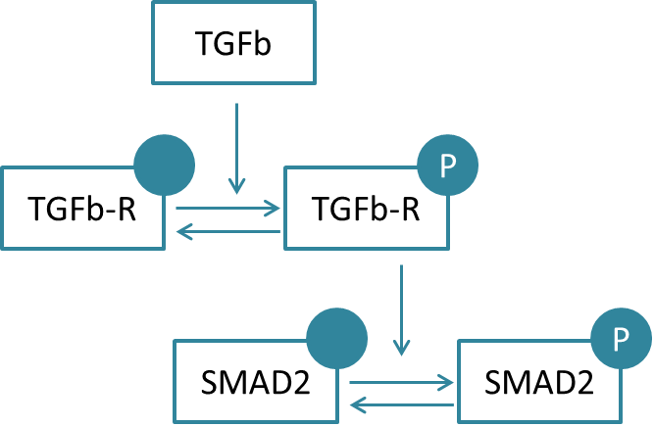
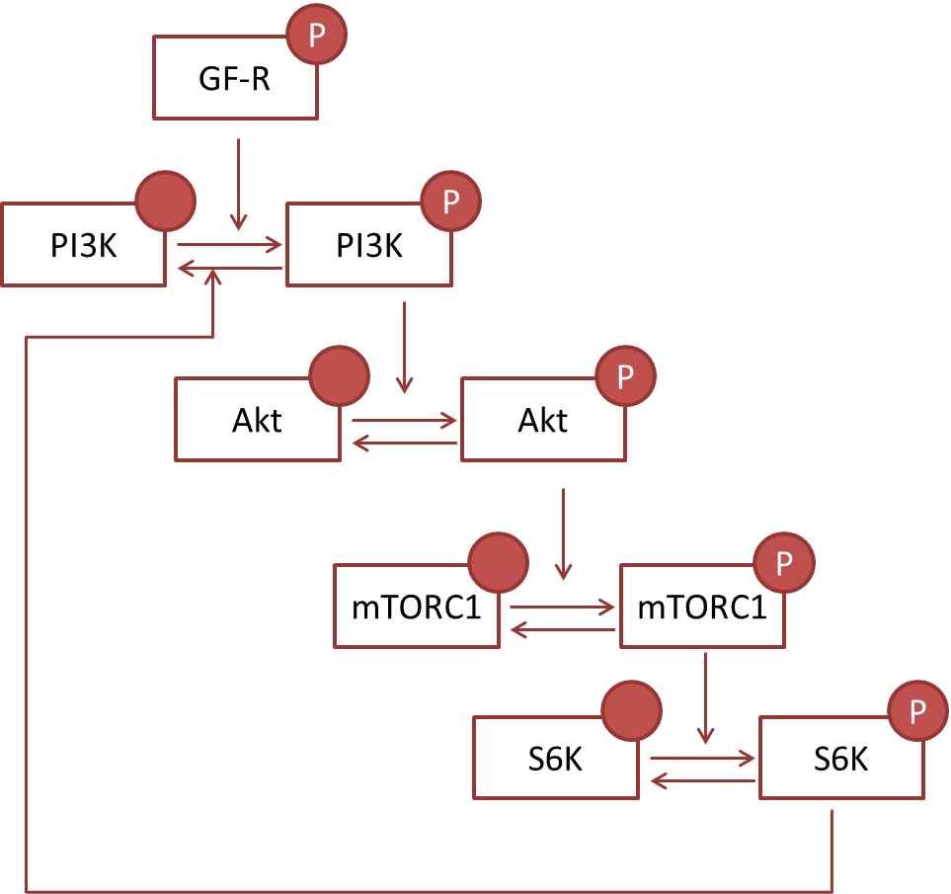
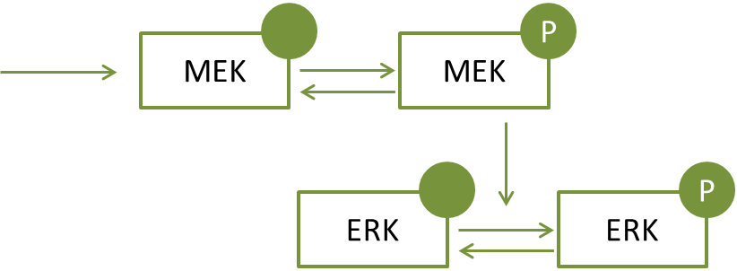
Crosstalks
v
v

Slide 5
Explanation of the crosstalks
PI3K activates MEK: PMID: 24327733
Akt inhibits MEK PMID: 10576742
MEK activates PI3K: PMID: 20563706
ERK activates mTORC1: PMID: 28286738
ERK activates S6K PMID: 11940578
ERK inhibits PI3K PMID: 17640984
TGFbR activates MEK PMID: 17673906

Slide 6
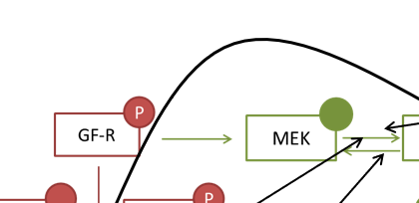
Points/Questions
I suspect this reaction a mistake
This reaction says “pGFR transitions to MEK” whereas I suspect you mean phosphorylate.
Is this correct?

Slide 7
Rate laws
Mass conservation?
Long time series, what can we assume to be constant?
Model Inputs
Kholodenko’s topology? With parameters?
Replace TGFb component with Vilar 2006 (or other?)
IS TGFb constant throughout simulation? IF so then TGFbR → TGFbR_a reduces to first order mass action.
Should we use repeats in the parameter estimations?
Concern over long time courses Vs
Bring EGFR in? How does the network behave with everything turned off except EGFR?
Hill equation for TGFbR activation. Produce a dose response curve that is realistic, i.e. sigmoidal.
Does a similar relationship exist for pGFR and PI3K/MEK??
Concerns about dephos of Smad2 – This reaction encompasses a lot.
Model TGFb as modifier or binding?

